Slide 1

LifeSource
EC6060- Software Engineering Final Project

Slide 2
Collaborators
2018/E/012 ARSHATH J.M.
2018/E/083 NAYANAJITH Y.G.A.
2018/E/085 NUWANSIRI W.D.A.
2018/E/102 RODRIGO S.M.
2

Slide 3

Reason?
Lack of technique to indicate blood reservation
Lack of media support for informing emergencies and blood donation camps
Not reaching the information among donators
3

Slide 4
Requirement Gathering
To update blood records regularly
Inform donations who wiling to donate
Find donators in critical situations
Propper arrangement
4

Slide 5
Requirement Analysis
Insufficient blood storage
Problems in information flow
Lack of negative blood donors
Finding blood in emergencies
Traffic in blood donation campaigns
5

Slide 6
Solution Statement
By using this application,
Organizers can able to create a post and send notifications to the donators and distribute the information to a large audience.
Preserve a separate section for negative blood donors.
Emergency notification feature.
Timeslot recommendation feature
Increase the effectiveness of the direct donor option
6

Slide 7
Diagrams
7

Slide 8
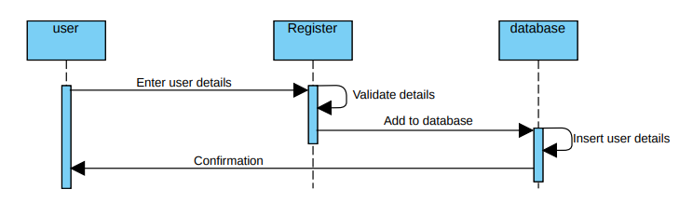
Sequence Diagram
Sequence diagram for user Registration
8

Slide 9
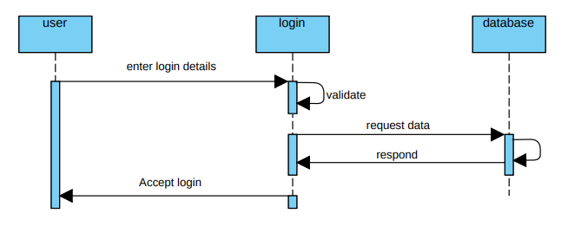
Cont…
Sequence diagram for user Login
9

Slide 10
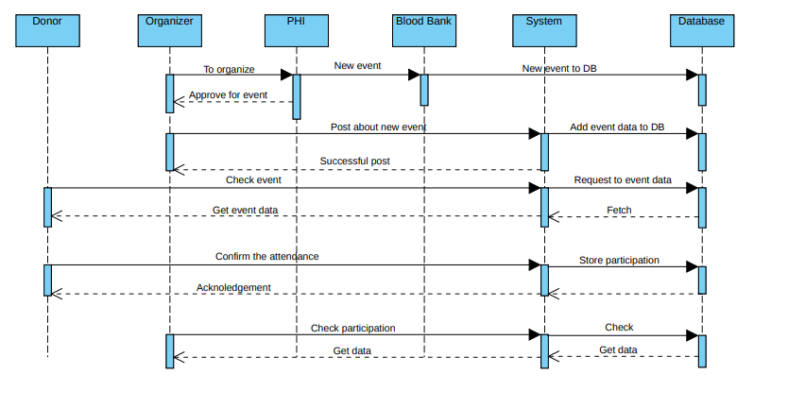
Cont…
Sequence diagram for event Registration, Publish, Search, Confirm attendance &
Check participation
10

Slide 11
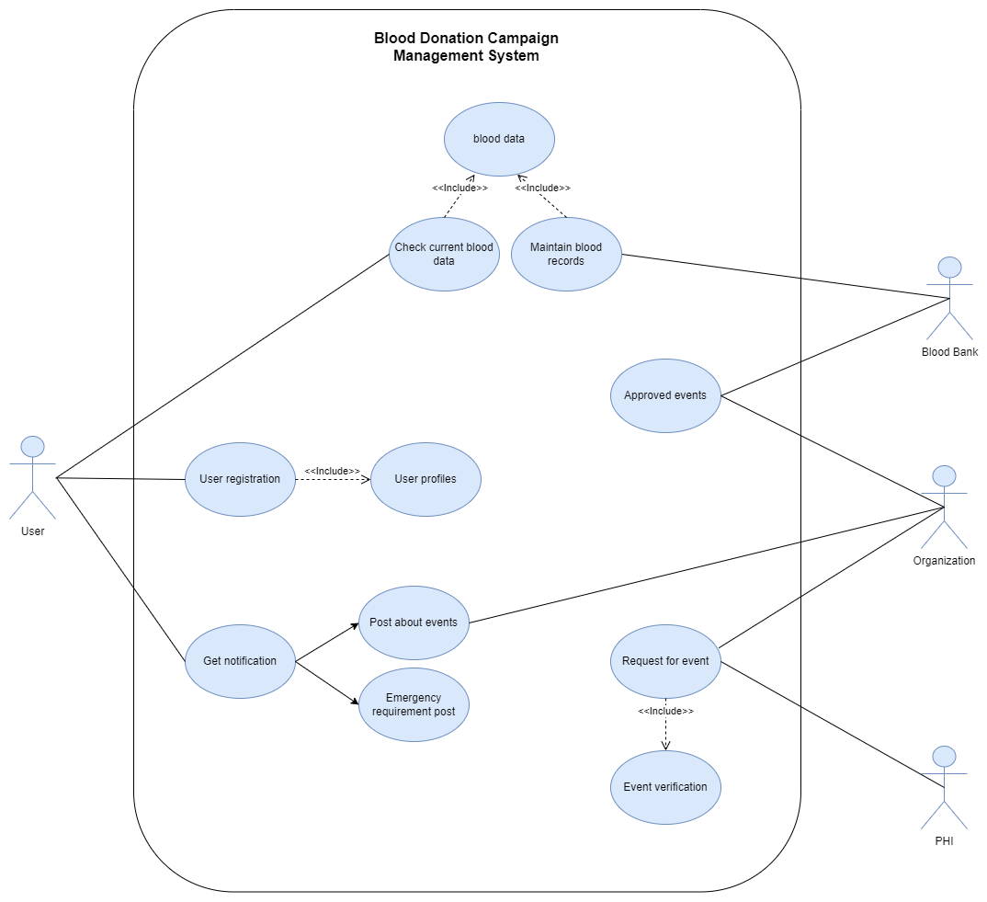
Use Case Diagram
11

Slide 12
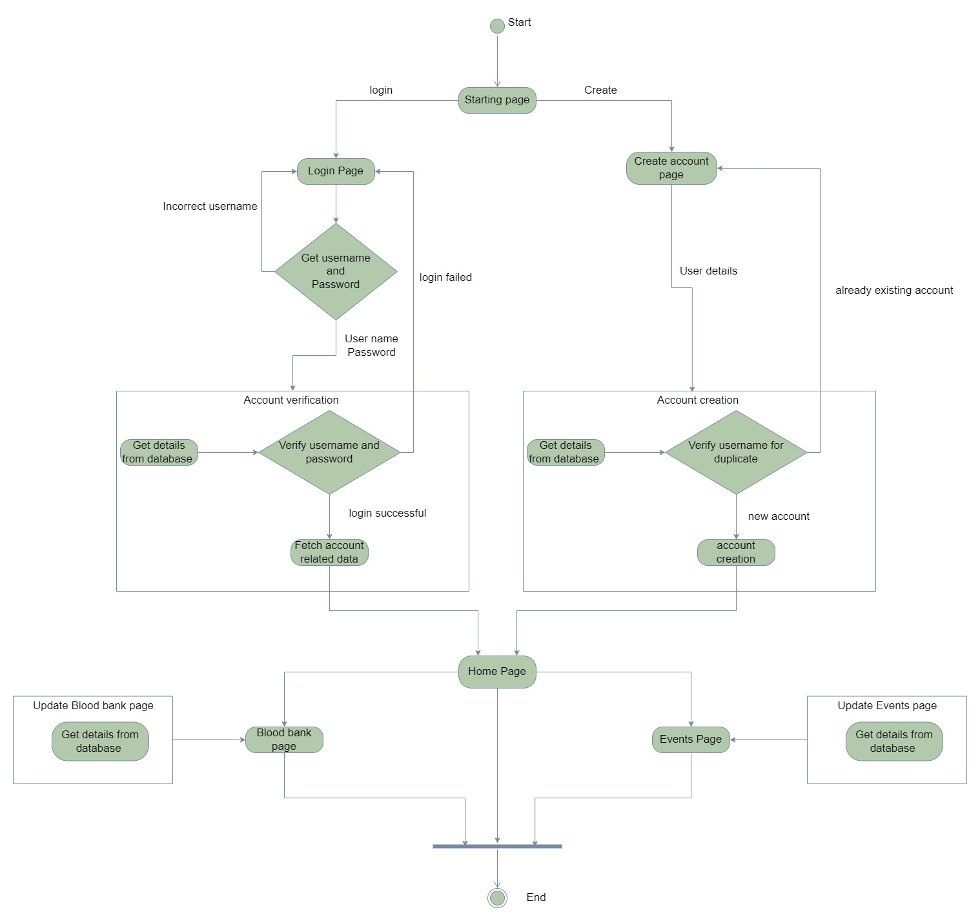
State Machine Diagram
12

Slide 13
Competitors
Simply Blood
Blood Donor (American Red Cross)
NZ Blood Service Donor App (New Zealand)
BloodLine (Bangladesh)
Live Blood Bank (Bangladesh)
13

Slide 14

Gap
Confirm the attendance
Emergency notification
Virtual Questioner
Section for negative blood donors
14

Slide 15
What we did?
15

Slide 16
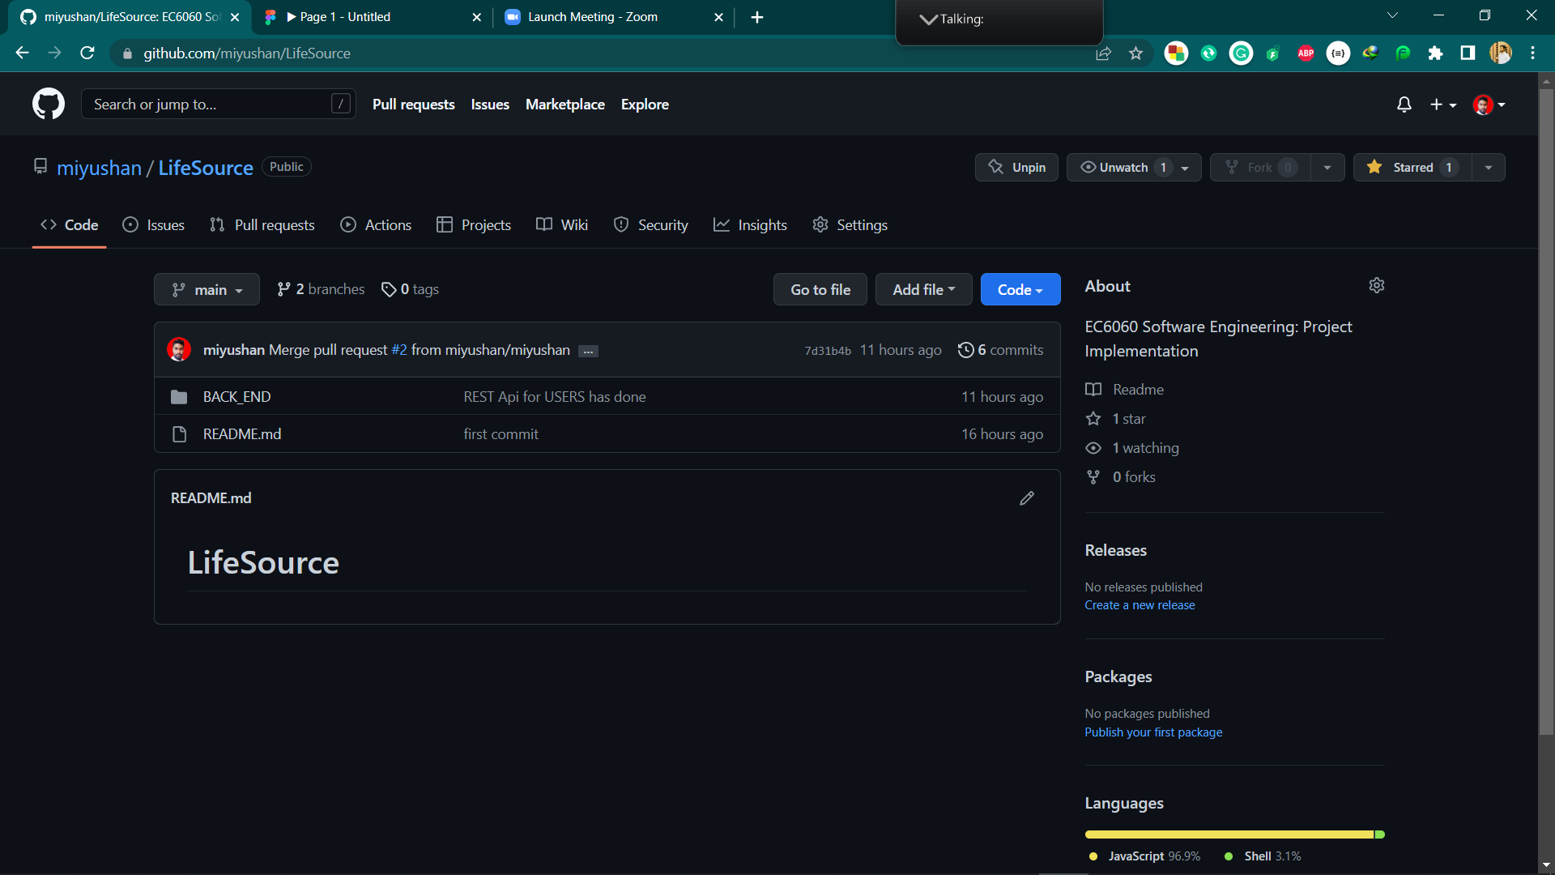
GitHub
16

Slide 17
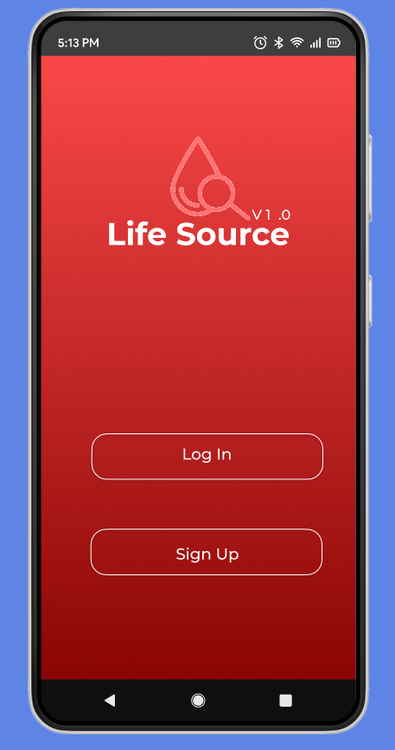
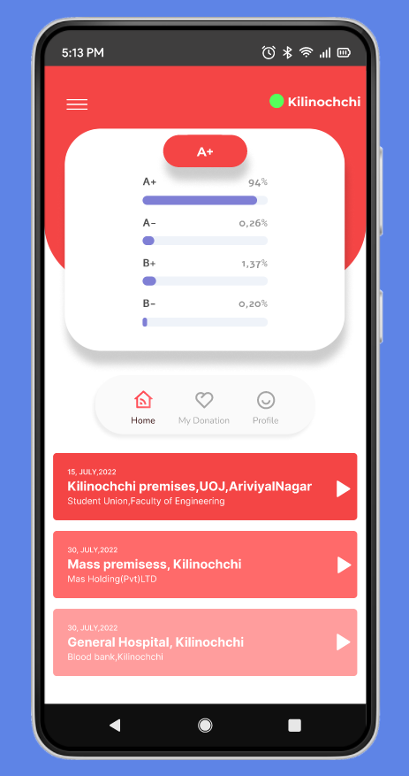
Figma
17

Slide 18
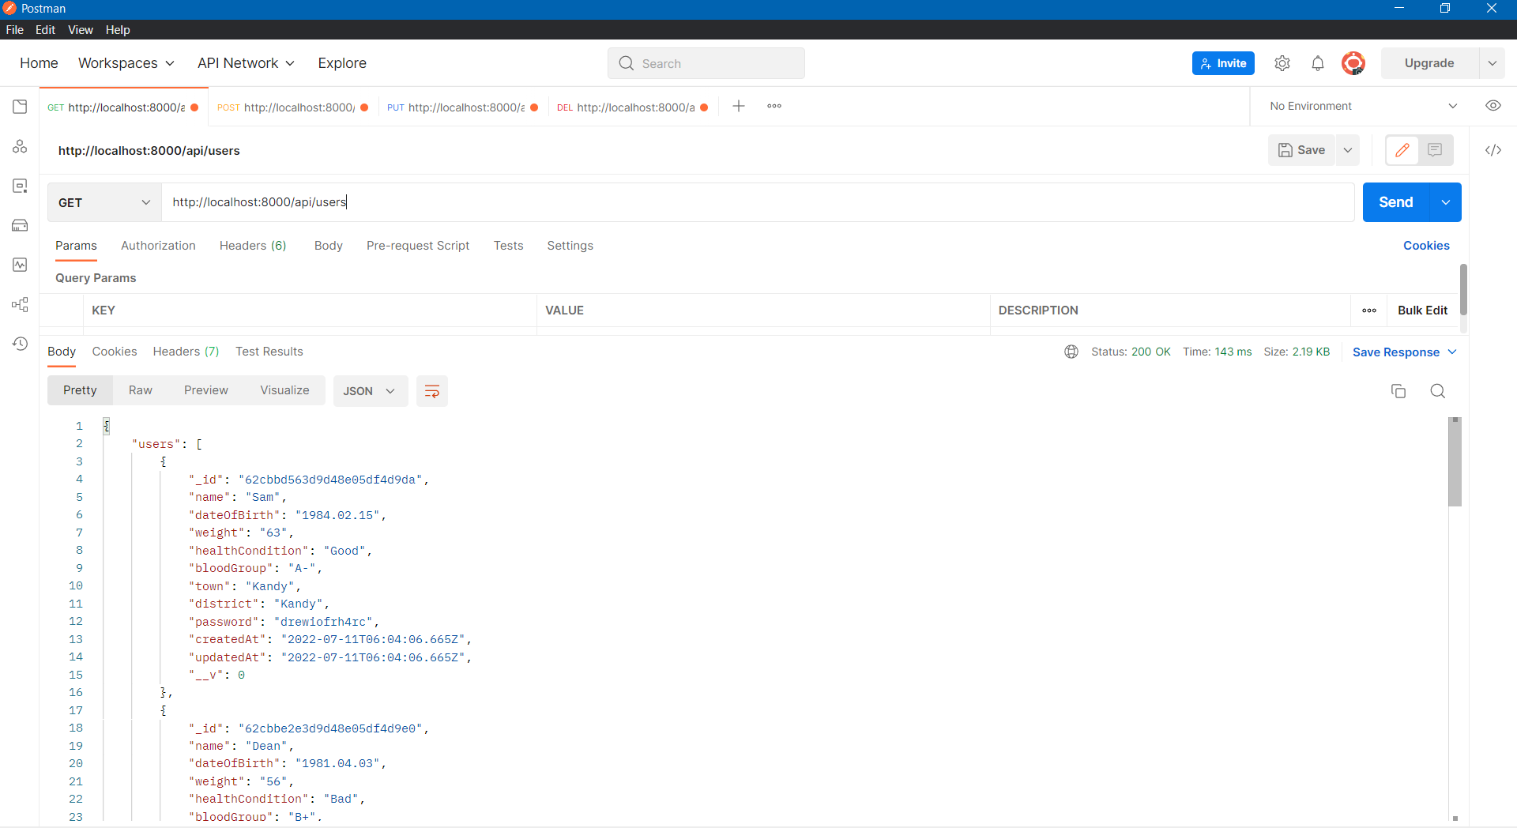
Postman
18

Slide 19
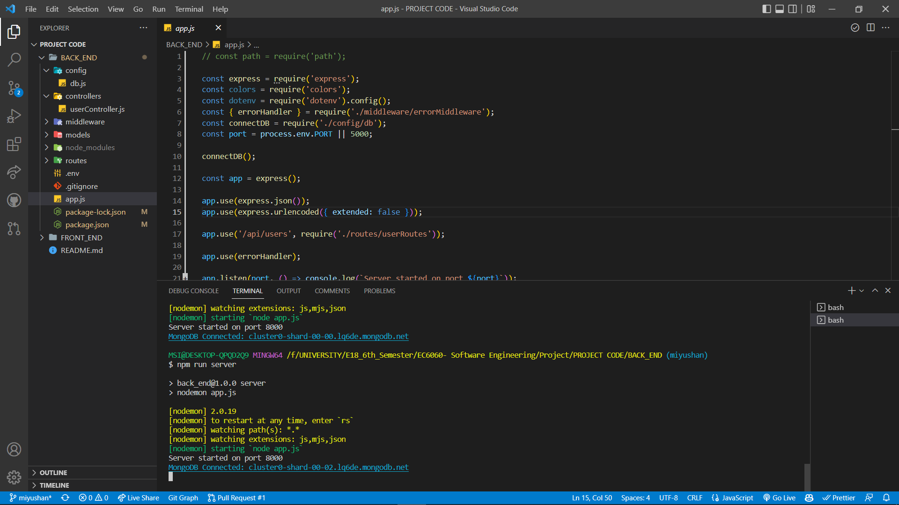
VS Code
19

Slide 20
Roadmap
 | 2018/E/012 | 2018/E/083 | 2018/E/085 | 2018/E/102
Planning
Requirement gathering
Requirement analysis
Setup the collaborative platforms
Design & prototyping
Database configuration
Initialize the backend
Testing
Develop the frontend
Product deployment
Fix bugs and update
20

Slide 21

Thank You!
21

